Slide 1
Marketing Campaign Analysis Using Logistic Model
Group – 8
PRITHWIJIT GHOSH(211349)
SHIVAM(211381)
SAPRATIVA BHOWAL(211371)
PRATIBHA VISHWAKARMA(211346)

Slide 2
INTRODUCTION
Every company or authority wants to make some plans or campaign such that the offer provided by the company are accepted by the customers and for this every company use some statistical analysis behind offering those campaign such that the customer grab the offer and the company make a high level profit to choose our dataset Marketing Campaign to see how this statistical analysis and the model building criteria helps them to make a handful of profit.

Slide 3
GOAL OF OUR STUDY
Encoding the categorical columns into corresponding dummy variables.
Checking for outliers and if it exists then replace them by their suitable estimates.
Checking for missing values and replace them by their corresponding estimates
Examine whether the data is imbalanced or not.
Fit our logistic model with full set of regressors.
Scrutinize the model for multicollinearity issue in the continuous predictor.
Finally, select the variables which are necessary and drop all other.

Slide 4
DATA DESCRIPTION
AcceptedCmp1 - 1 if customer accepted the offer in the 1st campaign, 0 otherwise
AcceptedCmp2 - 1 if customer accepted the offer in the 2nd campaign, 0 otherwise
AcceptedCmp3 - 1 if customer accepted the offer in the 3rd campaign, 0 otherwise
AcceptedCmp4 - 1 if customer accepted the offer in the 4th campaign, 0 otherwise
AcceptedCmp5 - 1 if customer accepted the offer in the 5th campaign, 0 otherwise
Complain - 1 if customer complained in the last 2 years
DtCustomer - date of customer’s enrolment with the company
Education - customer’s level of education
Marital - customer’s marital status
Kidhome - number of small children in customer’s household
Teenhome - number of teenagers in customer’s household
Income - customer’s yearly household income
MntFishProducts - amount spent on fish products in the last 2 years
MntMeatProducts - amount spent on meat products in the last 2 years 2
MntFruits - amount spent on fruits products in the last 2 years
MntSweetProducts - amount spent on sweet products in the last 2 years
MntWines - amount spent on wine products in the last 2 years
MntGoldProds - amount spent on gold products in the last 2 years
NumDealsPurchases - number of purchases made with discount
NumCatalogPurchases - number of purchases made using catalogue
NumStorePurchases - number of purchases made directly in stores
NumWebPurchases - number of purchases made through company’s web site
NumWebVisitsMonth - number of visits to company’s web site in the last month
Recency - number of days since the last purchase
Response (target) - 1 if customer accepted the offer in the last campaign, 0 otherwise

Slide 5
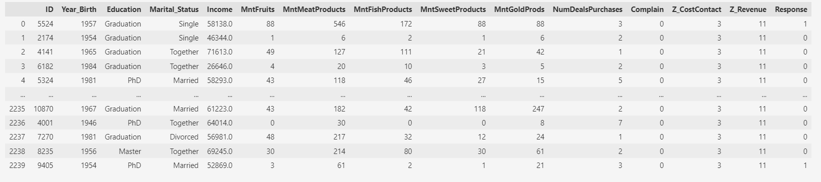
DATA-SET VISUALIZATION

Slide 6
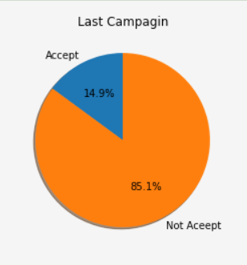
Exploratory Data Analysis(EDA)
EDA on response variable
It is clearly visible that the “Not Accepted” part is
heavily present in the data with respect to the
“Accepted” section.
Actually, 85.1% people have not accepted
the offer and only 14.9% accepted the offer.

Slide 7
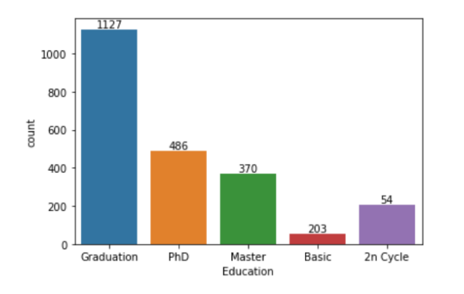
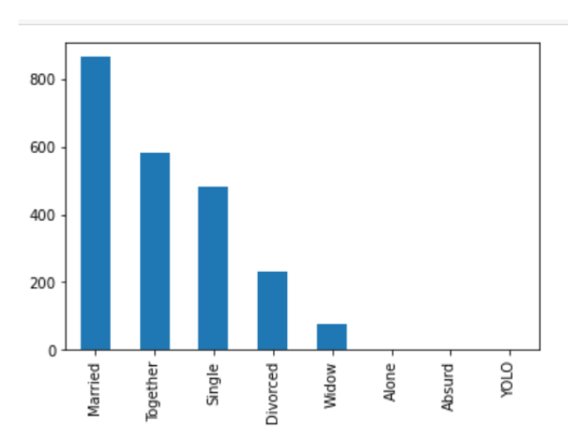
EDA(Cont..)
EDA on different regressor variables
Education Level of the Customer
Marital Status of the Customer
It is clearly obvious that the Customer’s Education level is significantly high and the married, together and single are fairly high than the other categories in the marital status.

Slide 8
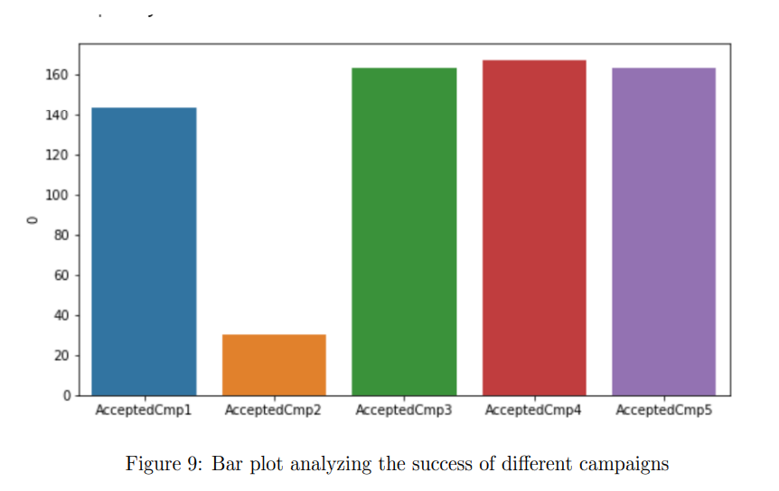
Bar plot analyzing the success of different campaigns
We can interpret from the bar plot that the third, forth and fifth campaigns were equally successful attracting approximately 160 customers but the second campaign was not up to the mark as it attracted just 30 customers.

Slide 9
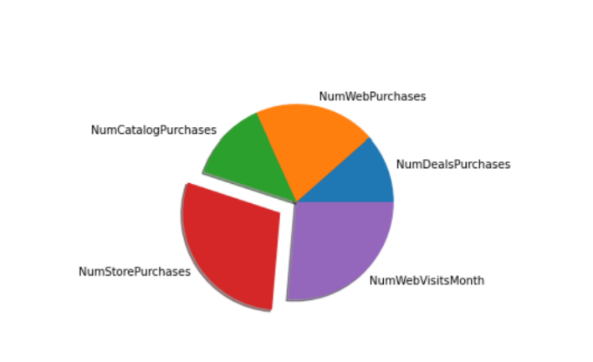
Pie chart for the Number of Purchases from the Different layout
From the pie graph, we can analyze that more than 50% of the purchases are from web visits or from the store purchases.

Slide 10
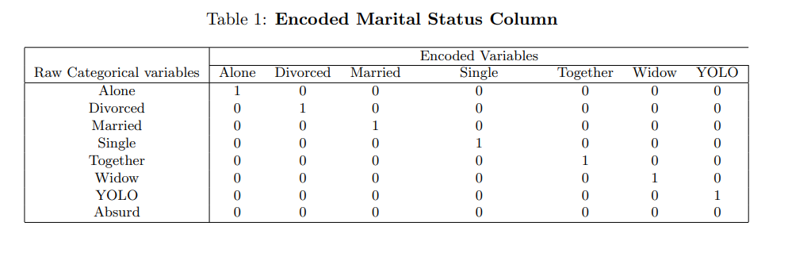
Data Encoding
In our dataset, there are two categorical columns (Marital Status and Education) which have to be encoded i.e. turned them into numerical values appropriately.
We use One Hot Encoding for the Marital Status column as they takes nominal values.
There are eight unique values in the marital status column. So, we take 7 (8-1) dummy variables.

Slide 11
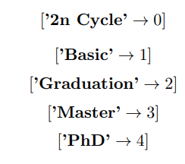
Data Encoding
We have another categorical column ”Education” but this column is a ordinal. So we can encode this column into the natural order i.e. based on the ordinality we place the values 1,2,.... up to final order.
So, we take the values as shown in the aside picture.

Slide 12
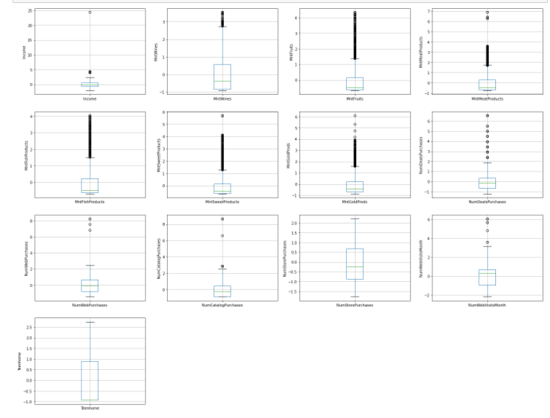
Outlier Detection
Outlier in the data plays a very important role when we came into the estimation purpose for the model parameters.
For our model we draw the box plots to see whether heavy amount of outliers present in our data or not.
Since too much outliers are present in the data, we have to estimate them.

Slide 13
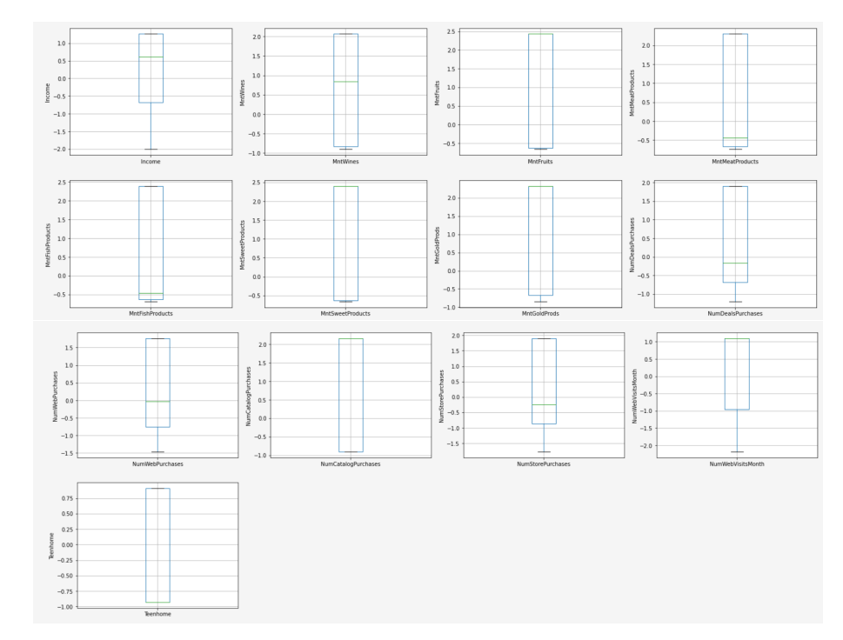
Outlier Detection
Here we apply Interquartile Range method (IQR) for outlier detection and removal of outliers by the median of the corresponding column.
Observing the boxplot, it is almost sure that the variables are skewed.
Hence we can say that, now our data is quite structured than the previous one.

Slide 14
Data Imputation for Missing Data
In our data, in the ‘Income’ column, only 24 observations are missing. So we can either delete them or estimate them.
Since we have estimated the outliers and balanced our data
Mean-imputation method is largely affected if some outliers present in the data. Because mean can shift towards the outliers and we may have tedious estimates via this method. But we first clean the outliers, then we apply the mean-imputation method.
So we apply the mean-imputation method for estimating the missing values.

Slide 15
Multicollinearity
Multicollinearity is a silent killer of any regression model.
If the multicollinearity is present in the data then all the coefficient magnitudes becomes very large, but the predicted value of the response variables may be highly satisfactory. But if we delete one row or one column then the model change drastically, the negative coefficient becomes positive, the largest coefficient may be smaller in the newer model and finally the prediction may be reversed the previous one.

Slide 16
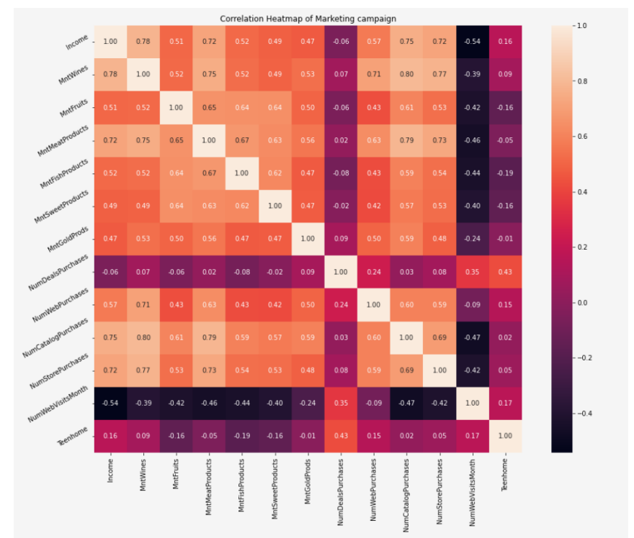
Simple Correlation Check
The correlation matrix is not only hard to interpret but also very difficult to visualize.
So, instead of correlation matrix we try to visualize it by the correlation heat map.
Here light colors represent the high positive correlation
The dark color represent the high negative correlation

Slide 17
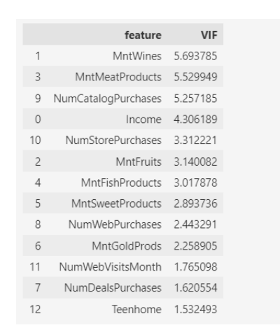
Variance Inflation Factor
Since the correlation matrix is not very informative for our data, we choose our second alternative procedure
If VIF value is greater then 5, we can say that multicollinearity is present in the model.
Else multicollinearity is not present in our model.

Slide 18
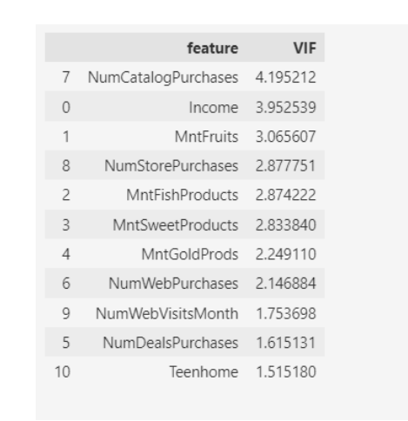
Variance Inflation Factor
For three columns ”MntWines”, ”MntMeatProducts”, ”NumCatalogPurchases” VIF values are greater than 5.
So here we drop the variable with highest VIF i.e. ”MntWines”
As the rule suggests, we have to find the VIF for all the variables present in the model except the one that is excluded last time.
none of the variables have VIF greater than 5, so we can say that multicollinearity is completely resolved.

Slide 19
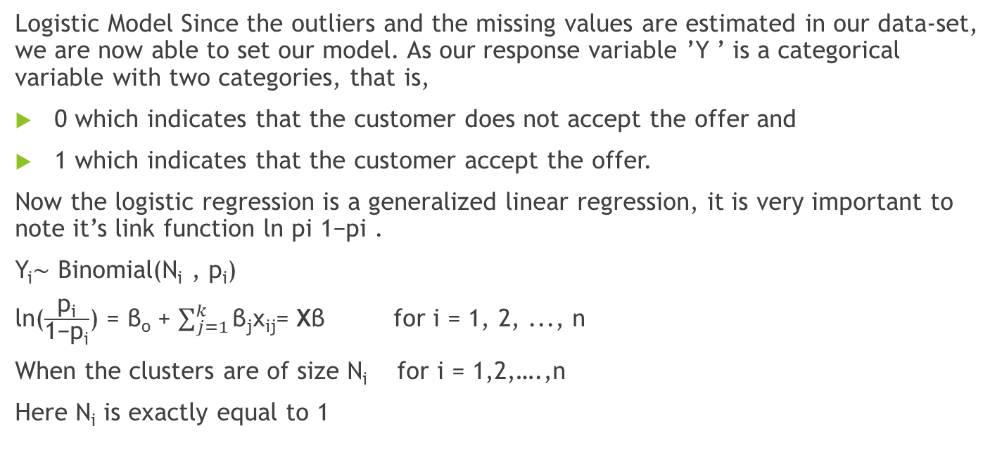
Model Description
Logistic Model Since the outliers and the missing values are estimated in our data-set, we are now able to set our model. As our response variable ’Y ’ is a categorical variable with two categories, that is,
0 which indicates that the customer does not accept the offer and
1 which indicates that the customer accept the offer.
Now the logistic regression is a generalized linear regression, it is very important to note it’s link function ln pi 1−pi .
Y_{i}∼ Binomial(N_{i} , p_{i})
ln($\frac{\text{p}\text{i}}{\text{1−}\text{p}\text{i}}$) = β_{o} + $\sum_{j=1}^{k}{\text{β}\text{j}\text{x}\text{ij}}$= Xβ for i = 1, 2, ..., n
When the clusters are of size N_{i} for i = 1,2,….,n
Here N_{i} is exactly equal to 1

Slide 20
Train Test
90% of the observations are used to train a model.
10% of the observations are used for predictive purpose
Choosing of 90% observations is done by Simple Random Sampling

Slide 21
Description of Confusion Matrix
1. TRUE Negative: If the predicted model says FALSE and the corresponding response is also FALSE.
2. TRUE Positive: If the predicted model says TRUE and the corresponding response is also TRUE.
3. FALSE Positive: If the predicted model says TRUE and the corresponding response is also FALSE.
4. FALSE Negative: If the predicted model says FALSE and the corresponding response is also TRUE.

Slide 22
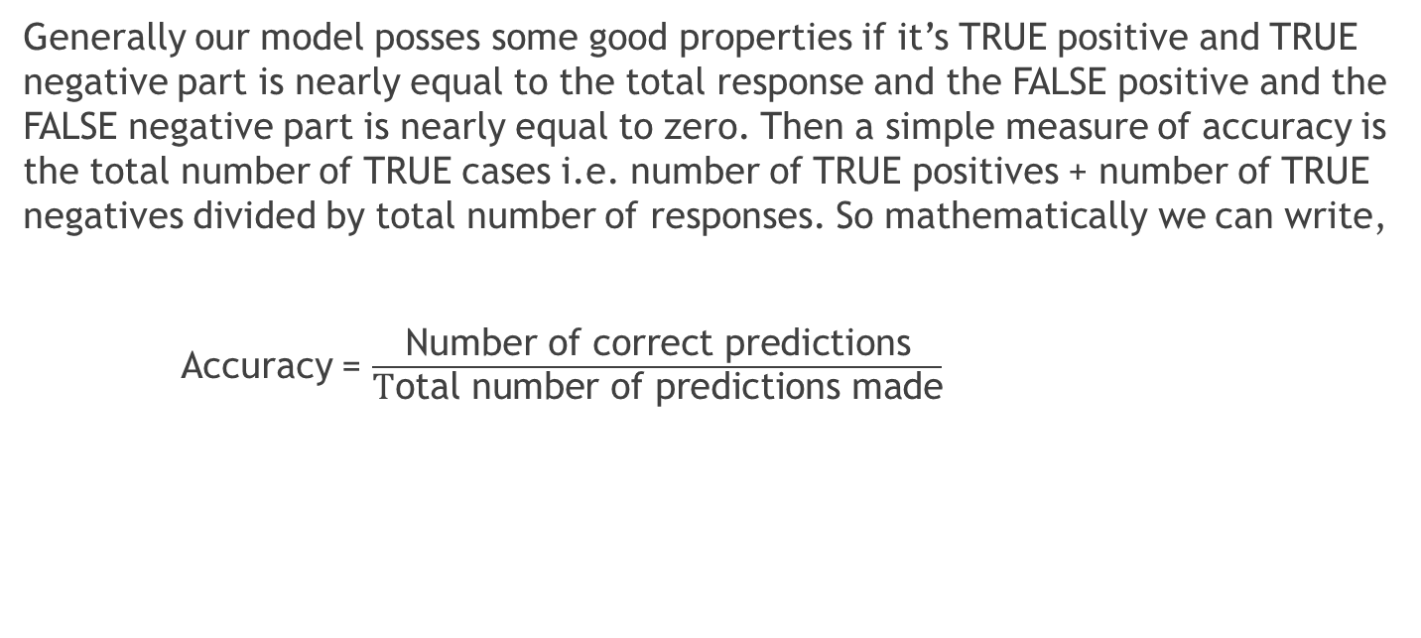
Accuracy Score
Generally our model posses some good properties if it’s TRUE positive and TRUE negative part is nearly equal to the total response and the FALSE positive and the FALSE negative part is nearly equal to zero. Then a simple measure of accuracy is the total number of TRUE cases i.e. number of TRUE positives + number of TRUE negatives divided by total number of responses. So mathematically we can write,
Accuracy = $\frac{\text{Number} \text{of} \text{correct} \text{predictions}}{\text{T}\text{otal} \text{number} \text{of} \text{predictions} \text{made}}$

Slide 23
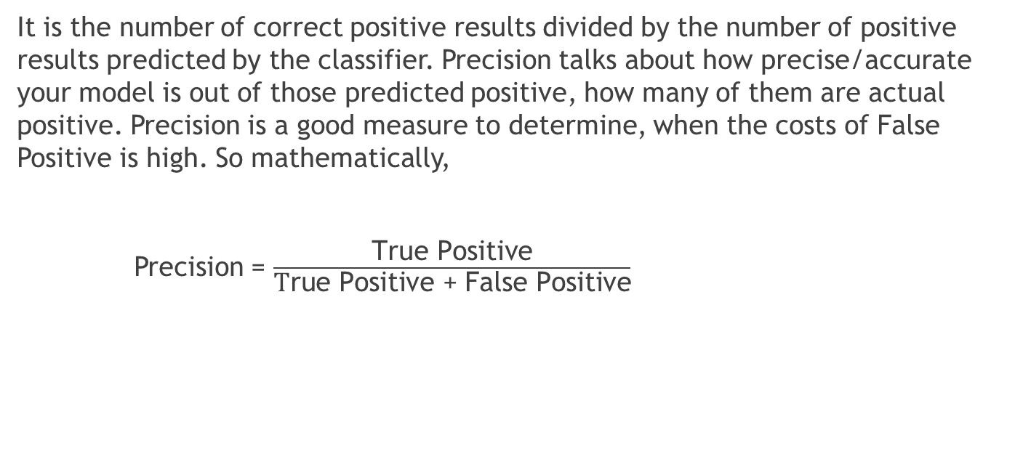
Precision Score
It is the number of correct positive results divided by the number of positive results predicted by the classifier. Precision talks about how precise/accurate your model is out of those predicted positive, how many of them are actual positive. Precision is a good measure to determine, when the costs of False Positive is high. So mathematically,
Precision = $\frac{\text{True} \text{Positive}}{\text{T}\text{rue} \text{Positive}\text{ + }\text{False} \text{Positive}}$

Slide 24

Specificity
Specificity, also known as the true negative rate, measures the proportion of actual negatives that are correctly identified as such. It is the opposite of the recall. So, mathematically we can write,
Specificity = $\frac{\text{True} \text{Negative}}{\text{Tr}\text{ue} \text{Negative}\text{ + }\text{False} \text{Positive}}$

Slide 25

F1 Score
The F1 Score is a measure of a test’s accuracy, that is, it is the harmonic mean of precision and recall. It can have a maximum score of 1 and a minimum of 0. Overall, it is a measure of the preciseness and robustness of the model.
F1 Score = $\frac{\text{2}\text{True} \text{Positive}}{\text{2}\text{Ture} \text{Positive}\text{+}\text{False} \text{Positive}\text{+}\text{False} \text{Negative}}$

Slide 26
ROC Curve
An ROC curve (receiver operating characteristic curve) is a graph showing the performance of a classification model at all classification thresholds. This curve plots two parameters: True Positive Rate. False Positive Rate. The ROC curve is produced by calculating and plotting the true positive rate against the false positive rate for a single classifier at a variety of thresholds. For example, in logistic regression, the threshold would be the predicted probability of an observation belonging to the positive class.

Slide 27
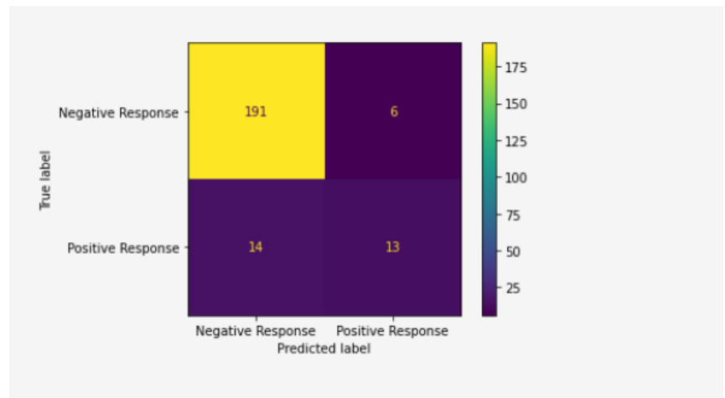
Confusion Matrix
Accuracy = 0.91
Precision = 0.68
Specificity = 0.93
F1 Score = 0.56
Confusion matrix is actually a mathematical representation of the perfectness and the failure of the model.
Here the confusion matrix corresponding to the train test model.

Slide 28
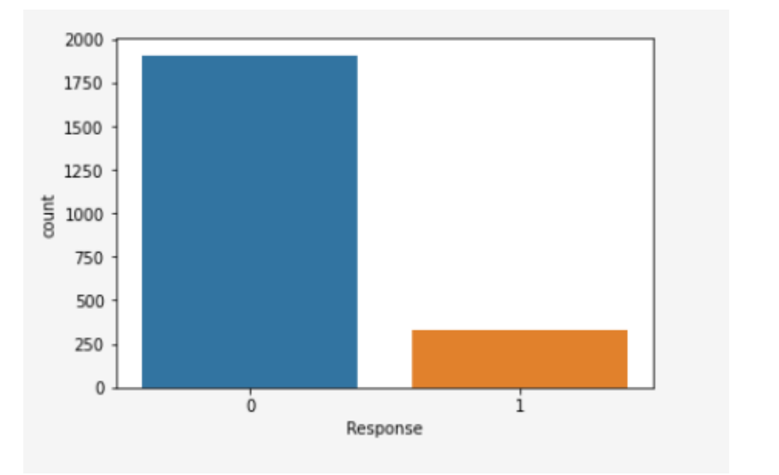
Data Imbalance
Since the number of zeros in the response variable is really too large than the number of ones – indicating the data is actually imbalanced.

Slide 29
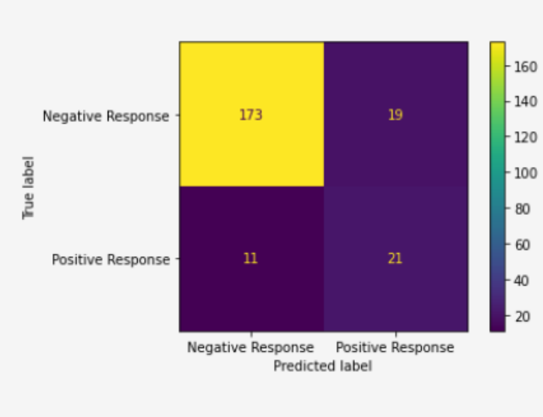
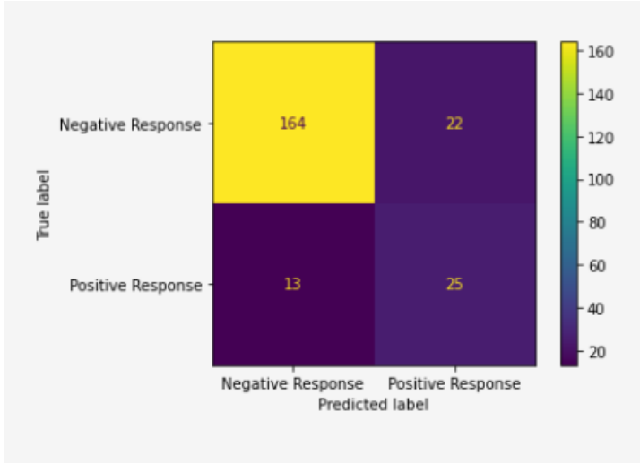
Handling with Data Imbalancing
Oversampling : SMOTE :
By this method we enhancing the This is also a oversampling technique minority class by replication. by synthesizing new samples .
The confusion matrix for The confusion matrix for Oversampling SMOTE

Slide 30
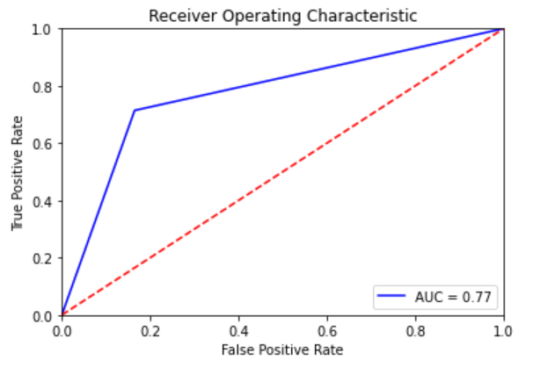
Fitting with full model AUC Score – Model with higher AUC is better
Here AUC score 0.77 seems pretty well

Slide 31
Variable Selection
Stepwise
• We start with the intercept model and compute the AIC for the model.
• We then compute AIC for all the possibilities of adding one more variable in our intercept only model. We select the variable with the smallest AIC if it has a lower AIC than intercept only model.
• We then again compute AIC for adding one more variable in the model along with the AIC for removing the already added variable. We sort the values by ascending order and variables are either added or the existing variable is subtracted depending on the value of AIC.
• We continue performing these steps until any further action - addition or subtraction, results in increase of AIC of the model.

Slide 32
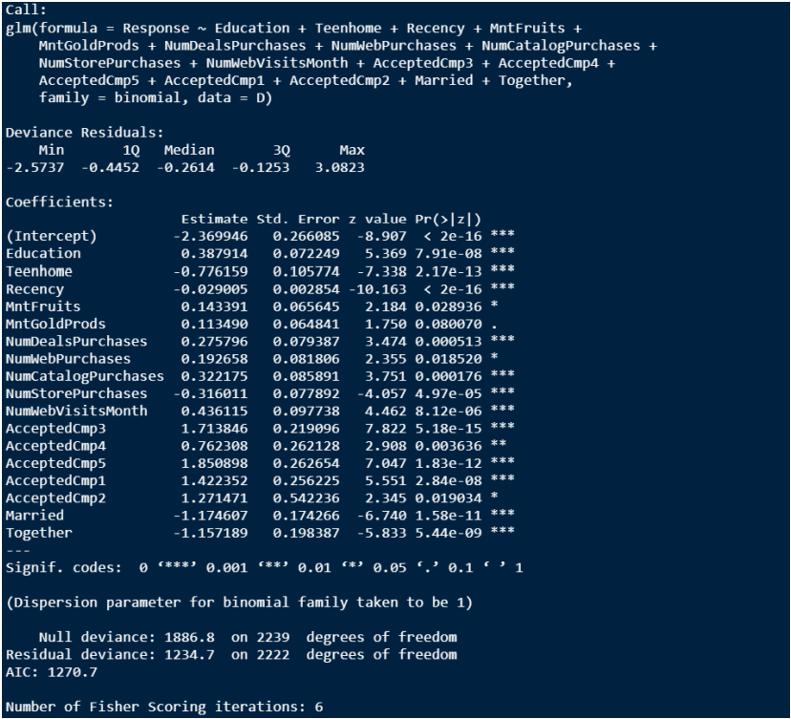
Variable Selection Output

Slide 33
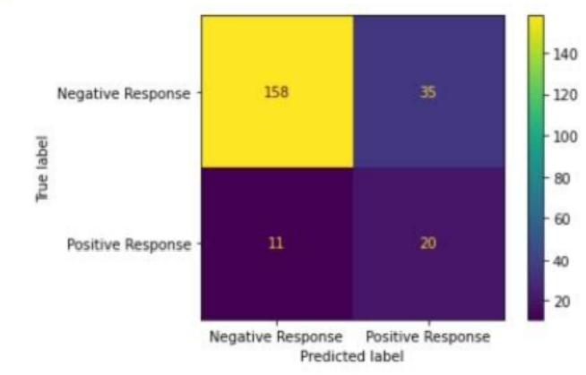
Final Model
The confusion matrix for the final matrix.
Accuracy = 0.79
Precision = 0.36
Specificity = 0.93
F1 Score = 0.46

Slide 34
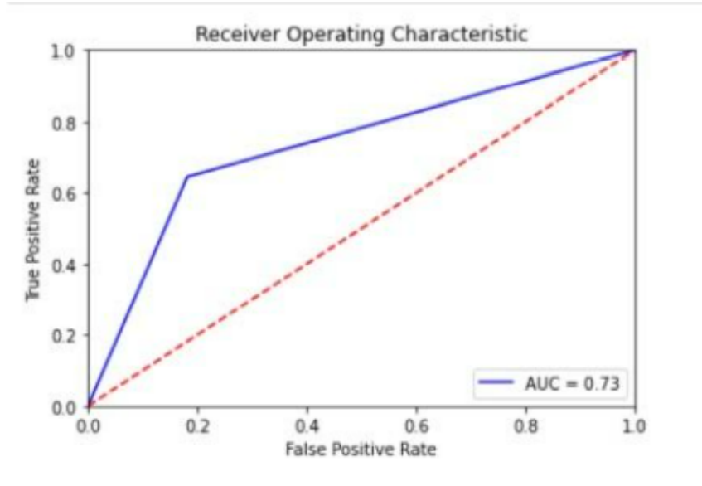
Final Model Checking
ROC curve with AUC score 0.73 which is quite better

Slide 35
Conclusion
Initially, we started with the data pre processing steps such as dealing with Missing Data and Imbalanced Data.
We found during these steps that the Marketing Campaign Dataset suffered from various serious problems and necessary actions were needed before modelling the data. We therefore used multiple data imputation techniques and created synthetic samples to deal with issues of missing and imbalance data.
After obtaining a complete dataset, we found that there is severe multicollinearity in our dataset. To tackle the problem of multicollinearity, we used VIF iterative algorithm for eliminating variables from our model.
Post elimination of Multicollinearity, we switched to the problem of Variable Selection and implemented Stepwise Regression to reduce dimensionality of our model.

Slide 36
Thank You

